Slide 1
Angular – dag 2 Korte herhaling
Peter Eijgermans – peter.eijgermans@ordina.nl

Slide 2


Angular
Components
Data binding
Services
TypeScript
Routing
Classes
Form
Event binding
Observables
Templates Pipes Views
…

Slide 3
TypeScript
ES6
ES5

Slide 4
Component based A component adds logic to DOM elements
main.ts
AppModule
AppComponent
app.component.html
BookSearchComponent
DashBoardComponent
BooksComponent
BookDetalsComponent

Slide 5
Flow single page app
index.html
AppComponent
app.component.html
BookSearchComponent
DashBoardComponent
BooksComponent
BookDetalsComponent
Notes:
Angular is a tree of components, because it has the same structure as your html-structure !!!
Index.html is the parent template of AppComponent ect…
AppComponent is the parent of BookComponent and …
main.ts

Slide 6
Data binding
Nieuwe notatiewijzen in HTML-views/partials.
Simple data binding {{ … }}
Event binding (…)=“...”
One-way data binding […]=“...”
Two-way data binding [(ngModel)]
= “ …”

Slide 7
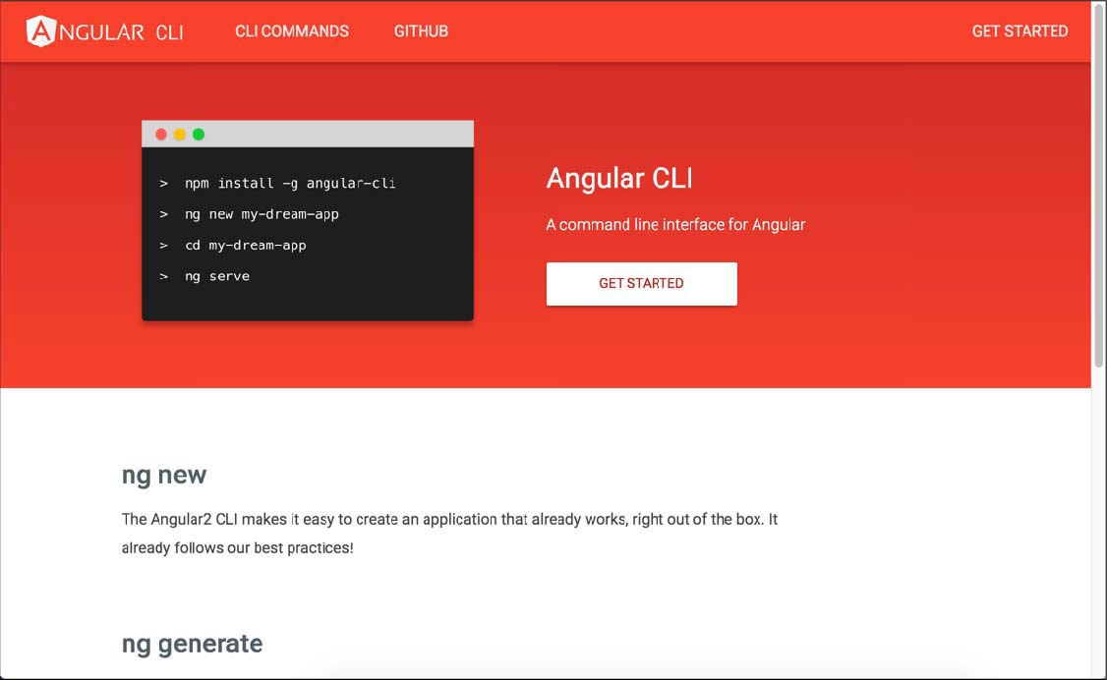
Angular CLI

Slide 8
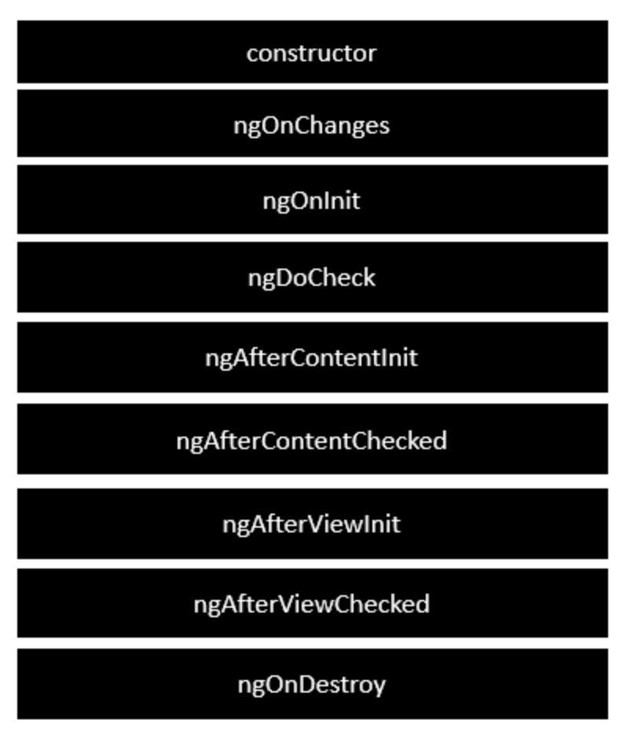
Life Cycle Hooks
https://angular.io/guide/lifecycle-hooks#lifecycle-examples
Notes:
Following is a description of each lifecycle hook.
ngOnChanges − When the value of a data bound property changes, then this method is called.
ngOnInit − This is called whenever the initialization of the directive/component after Angular first displays the data-bound properties happens.
ngDoCheck − This is for the detection and to act on changes that Angular can't or won't detect on its own.
ngAfterContentInit − This is called in response after Angular projects external content into the component's view.
ngAfterContentChecked − This is called in response after Angular checks the content projected into the component.
ngAfterViewInit − This is called in response after Angular initializes the component's views and child views.
ngAfterViewChecked − This is called in response after Angular checks the component's views and child views.
ngOnDestroy − This is the cleanup phase just before Angular destroys the directive/component.

Slide 9
Angular Constructor vs ngOnInit
https://www.linkedin.com/pulse/angular-constructor-vs-ngoninit-madhumati-hosamani/

Slide 10
Services
Services
Static services
Observables / rxJS
GET-ing data

Slide 11
Waarom een Service?
gegevens centraal veilig stellen
gegevens bereikbaar voor andere componenten
gegevens gaan niet verloren als je van component/view wisselt
(Component is vluchtig !)

Slide 12
Data flow
View
{{…}}
Class / Component
Service
Uiteindelijk: veilig stellen in database via Ajax, met Http
API → Database

Slide 13
Observables
Notes:
You are a Observer = Listener and Subscriber on the data
TV is the Observable = Provider of Async data

Slide 14
Observable
Returns a stream of values over time

Slide 15
Vandaag
Game Observables
Vervolg Observables
async-pipe
Tree of components
Applicaties opbouwen met meerdere componenten
Data flow tussen de componenten
Routing
App maken

Slide 16
Architecture Angular project
https://medium.com/@tomastrajan/6-best-practices-pro-tips-for-angular-cli-better-developer-experience-7b328bc9db81
Notes:
A good guideline to follow is to split our application into at least three different modules — Core, Shared and Feature

